Slide 1
Crop Yield Prediction Using KNN Prediction
Submitted in the partial fulfillment for the award of the degree of
BACHELOR OF ENGINEERING
IN
CSE – Artificial Intelligence & Machine Learning
Submitted by:
Ojasri Konda(21BCS6189)
Navmi Rajeev(21BCS6165)
Rehan Sharief(21BCS6201)
Aryan Verma(21BCS6199)
Under the Supervision of:
Ms. Shubhangi Mishra
Department of AIT-CSE
DISCOVER . LEARN . EMPOWER

Slide 2
Outline
Introduction to Project
Problem Statement
Objectives of the work
Methodology used
Results and Outputs
Conclusion
Future Scope
References

Slide 3
INTRODUCTION TO PROJECT
Nowadays, farmers encounter several significant challenges that impede their agricultural operations.
One critical issue revolves around resource allocation.
In the absence of accurate predictions, farmers struggle to allocate resources like water, fertilizers, and pesticides efficiently.
This often leads to either excessive use, resulting in unnecessary costs, or insufficient application.
Unpredictable market conditions present another obstacle.
This uncertainty can result in surplus or shortage situations, leading to price fluctuations and decreased profitability
Thus, absence of accurate predictions lead to reduced crop yields.

Slide 4
INTRODUCTION TO PROJECT
Problems faced by farmers with lack of Yield Prediction Models :
Uncertainty in Resource Allocation
Risk Exposure
Market Uncertainty
Financial Instability
Suboptimal Decision Making
Environmental Impact

Slide 5

PROBLEM STATEMENT
Farmers lack deep understanding of how AI models predict crop yields, limiting their trust and ability to optimize practices. We propose a solution combining saliency maps in KNN and interactive XAI dashboards, allowing farmers to visualize key factors impacting yield predictions and adjust their decisions accordingly, fostering trust and sustainable agricultural practices.

Slide 6
OBJECTIVES OF THE WORK
Develop a Crop yield prediction model using KNN.
Develop KNN models with embedded saliency maps.
These maps will visually highlight the critical features, like rainfall or soil nutrients.
Build interactive XAI dashboards.
Farmers can use them input their field data and receive AI-powered yield predictions alongside clear explanations.
Evaluate the impact of explain ability.

Slide 7
FLOW CHART
Start
Model Training
Prediction
Data Collection & Import
Feature Scaling
XAI Dashboards
Preprocessing
Converting Categorical to Numerical
Data Representation
Train-Test Split

Slide 8
METHODOLOGY USED
Data Collection and Import: Imported the "yield_df.csv" dataset into the programming environment using appropriate libraries such as pandas.
Data Preprocessing: Dropped null values & removed duplicate entries.
Data Representation: Created graphical representations of various aspects of the dataset.
Train-Test Split: Employed train_test_split function from scikit-learn to split the dataset into training and testing sets.
Converting Categorical to Numerical: Utilized techniques such as one-hot encoding or label encoding to convert categorical variables into numerical representations suitable for model training.

Slide 9
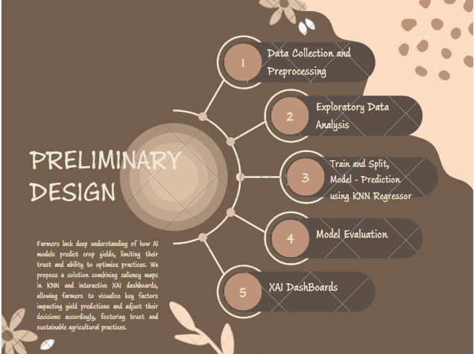
PRELIMINARY DESIGN

Slide 10
METHODOLOGY USED
6. Feature Scaling: Used StandardScaler from scikit-learn to scale the values of numerical features.
7. Model Training: Utilized the KNeighborsRegressor class from scikit-learn to train the KNN regression model on the training data
8. Prediction: Utilized the trained KNN regression model to predict crop yields on the testing dataset.
9. XAI dashboards: Using interactive XAI dashboards, allowed farmers to visualize key factors impacting yield predictions.

Slide 11
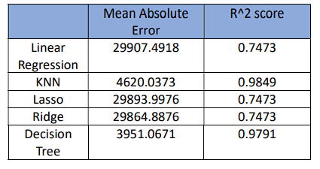
RESULTS AND ANALYSIS
The performance metrics of Mean Absolute Error (MAE) and R^2 score was evaluated in the assessment of different regression models, such as Lasso, Ridge, KNN (K-Nearest Neighbors), and Linear Regression. An R^2 score of 0.7473 and an MAE of 29,907.4918 were obtained by Linear Regression. With a high R^2 score of 0.9849 and a muchdecreased MAE of 4,620.0373, KNN showed enhanced performance and great predictive abilities. Remarkably, the R^2 scores of 0.7473 for both the Lasso and Ridge regression models were identical to those of Linear Regression, and their MAE values were 29,893.9976 and 29,864.8876, respectively.

Slide 12
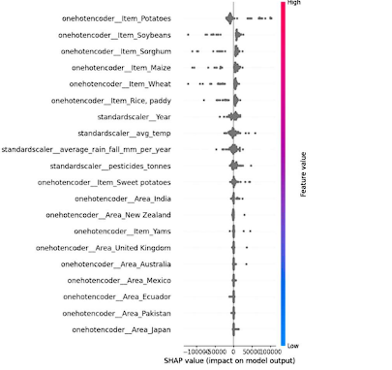
SHAP ANALYSIS

Slide 13
SHAP ANALYSIS
SHAP (SHapley Additive exPlanations) summary graphs illustrate the relationship between features and a target variable in a machine learning model. Each data point represents a feature, with its influence on the model's average rainfall prediction depicted by the SHAP value on the y-axis.
Analyzing SHAP summary plots reveals valuable insights into how various parameters affect the model's forecast of average rainfall. Features with SHAP values near zero, like 'standardscaler_average_rain_fall_mm_per_year,' have minimal impact, while positive values for features like 'onehotencoder_Area_India' and 'onehotencoder_Area_Mexico' indicate a positive correlation with higher expected rainfall. Conversely, features with negative SHAP values, such as 'onehotencoder_Item_Rice, paddy,' suggest a connection to lower rainfall predictions.
These observations provide crucial information about the relative importance of different features in the model's predictions, guiding future research and decision-making regarding farming methods and resource management techniques.

Slide 14
CONCLUSION AND FUTURE SCOPE
To sum up, this project has shown how to use machine learning approaches, including SHAP analysis, to effectively gather useful insights into the elements impacting agricultural outcomes, especially the prediction of average rainfall. We have discovered important characteristics that greatly influence the model's predictions through the SHAP summary plot analysis, providing insight into the intricate interaction between crop-related variables and average rainfall. There is a great deal of room to grow from this research in the future by investigating other machine learning methods, improving feature engineering techniques, and adding larger datasets. Moreover, based on these prediction models, future efforts can concentrate on creating systems that assist farmers' and other agricultural stakeholders' decisions and offer practical advice. We can enable agricultural communities to make well-informed decisions, improve resource allocation, and develop sustainable practices in the face of changing environmental problems by keeping up with innovation and integrating cutting-edge analytical approaches.

Slide 15
REFERENCES
Sharma, P., Dadheech, P., Aneja, N., & Aneja, S. (2023). Predicting Agriculture Yields Based on Machine Learning Using Regression and Deep Learning. IEEE Access.
Bagheri, S., Cheung, G., & Eadie, T. (2023). Graph Sparsification for GCN Towards Optimal Crop Yield Predictions. arXiv preprint arXiv:2306.01725.
Albert, M. C., Hans, H., Karteja, H., & Widianto, M. H. (2023, February). Development of Hydroponic IoT-based Monitoring System and Automatic Nutrition Control using KNN. In 2023 International Conference on Computer Science, Information Technology and Engineering (ICCoSITE) (pp. 974-979). IEEE.

Slide 16
REFERENCES
4. Shreya, S., Chatterjee, K., & Singh, A. (2023). BFSF: A secure IoT based framework for smart farming using blockchain. Sustainable Computing: Informatics and Systems, 40, 100917.
5. Kwaghtyo, D. K., & Eke, C. I. (2023). Smart farming prediction models for precision agriculture: a comprehensive survey. Artificial Intelligence Review, 56(6), 5729-5772.
6. Islam, M. M., Adil, M. A. A., Talukder, M. A., Ahamed, M. K. U., Uddin, M. A., Hasan, M. K., ... & Debnath, S. K. (2023). DeepCrop: Deep learning-based crop disease prediction with web application. Journal of Agriculture and Food Research, 14, 100764.
7. Sharma, P., Dadheech, P., & Senthil, A. S. K. (2023). AI-Enabled Crop Recommendation System Based on Soil and Weather Patterns. In Artificial Intelligence Tools and Technologies for Smart Farming and Agriculture Practices (pp. 184-199). IGI Global.

